Slide 1

African Swine Fever (ASF)
Prevention Training
Korea Pork Producers Association
Korea Association of
Swine Veterinarians
Korea Pork Board

Slide 2

Table of Contents
Understanding of African Swine Fever (ASF)
Risk factors of ASF outbreak and
the outbreak pathway
Duty of Han Don farms

Slide 3
1. Understanding of
African Swine Fever (ASF)

Slide 4
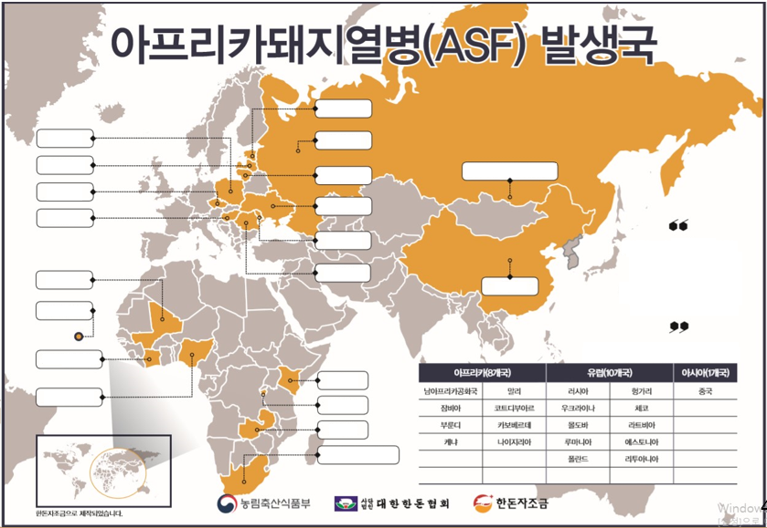

1) ASF outbreaks (based on Jan 2016 - Aug 2018)
The first outbreak of ASF in China on Aug 3rd
beyond Europe… Korea is exposed to danger as well.
Estonia
Poland
Russia
Latvia
Lithuania
Russia
(Neighboring area to Mongolia)
Czech
Republic
Hungary
Ukraine
Moldova
Practicians of Han Don farms and livestock industry should refrain from traveling to countries with ASF outbreak.
Mali
Romania
China
Cape Verde
Côte d'Ivoire
Based on Jan 1st, 2016 - Aug 20th, 2018
Kenya
Africa (8 countries) |  | Europe (10 countries) |  | Asia (1 country)
South Africa | Mali | Russia | Hungary | China
Zambia | Côte d'Ivoire | Ukraine | Czech Republic
Burundi | Cape Verde | Moldova | Latvia
Kenya | Nigeria | Romania | Estonia
 |  | Poland | Lithuania
Nigeria
Burundi
Zambia
South Africa
Korea Pork
Producers Association
Korea Pork Board
Produced with Han Don self-helf cost.

Slide 5
1) ASF outbreaks (based on Aug 2018)
ASF outbreak has been observed in Liaoning, Henan, Jiangsu, Zhejiang, Anhui and other provinces in China where lots of human interchanges occur with Korea; Preparation for preventing potential epidemics in entire China required.
ASF outbreaks in China (based on Aug 31st, 2018)
No. | Date | Region | Livestock rearing | Dead livestock | Note
1 | Aug 3rd, 2018 | Shenyang, Liaoning | 383 | 47 | Stamping out 7,733 heads within 3km
2 | Aug 16th, 2018 | Zhengzhou, Henan | 260 | 30 | Discovered in the slaughterhouse *Farms originated from Heilongjiang were tested negative.
3 | Aug 19th, 2018 | Ungang, Jiangsu | 615 | 88
4 | Aug 23rd, 2018 | Wenzhou, Zhejiang | 430 | 340
5 | Aug 30th, 2018 | Wuhu, Anhui | 459 | 80

Slide 6
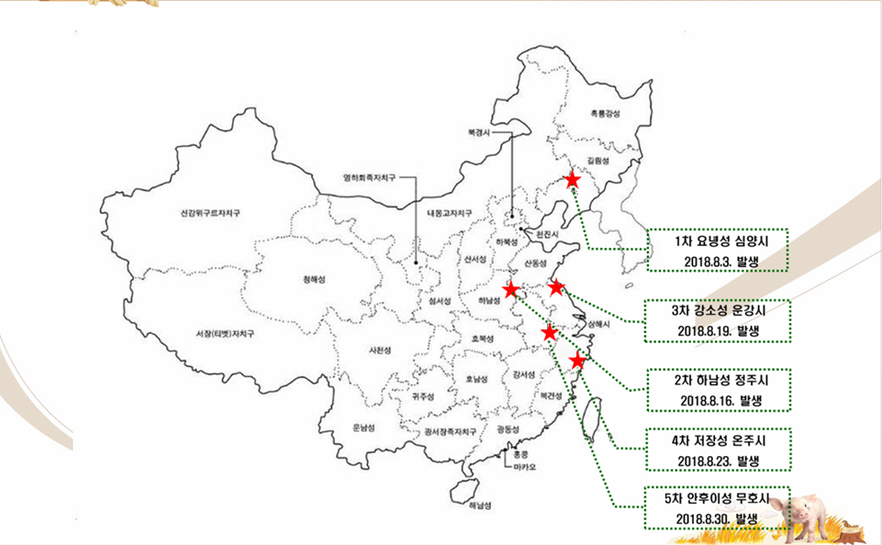
1) ASF outbreaks (based on Aug 2018)
ASF outbreaks in China (based on Aug 31st, 2018)
Heilongjiang
Beijing
Jilin
Ningxia
Liaoning
Xinjiang Uygur
Inner Mongolia
Hebei
Tianjin
1st outbreak
Shenyang, Liaoning
Aug 3rd , 2018
Shanxi
Shandong
Qinghai
Gansusheng
Shaanxi
Henan
Jiangsu
3rd outbreak
Ungang, Jiangsu
Aug 19th, 2018
Tibet(Xizang) Autonomous Region
Anhui
Shanghai
Sichuan
Chongqing
Hubei
Zhejiang
Hunan
Jiangxi
2nd outbreak
Zhengzhou, Henan
Aug 16th, 2018
Guizhou
Fujian
Yunnan
Guangxi Zhuangzu
Guangdong
Taiwan
4th outbreak
Wenzhou, Zhejiang
Aug 23rd, 2018
Hong Kong
Macau
5th outbreak
Wuhu, Anhui
Aug 30th, 2018
Hainan

Slide 7
2) ASFV survival period
ASFV can survive in the frozen meat for 1,000 days
due to its high environmental resistance.
Category | ASFV survival period | Category | ASFV survival period
Meat with or without bones / ground meat | 150 days | Intestines | 105 days
Salted meat | 182 days | (Dried) Skin / Fat | 300 days
Cooked meat (30 minutes at 70℃) | 0 | Blood stored at 4℃ | 18 months
Dried meat | 300 days | Excretion at room temperature | 11 days
Smoked and boneless meat | 30 days | Decayed blood | 15 weeks
Frozen meat | 1,000 days | Contaminated pigsty | 1 month
Chilled meat | 110 days
Presented periods refer to known or estimated maximum periods, and they can be differed
by environmental temperature and humidity.
Refer to ASF FAO Manual (ASFV viability for each item related in livestock), etc.

Slide 8
2. Risk factors of ASF outbreak
and the outbreak pathway

Slide 9
Risk factors of outbreak
(Pork products) Illegal carrying of pork and pork processed goods by tourists who visited the countries of outbreak and residents of
such countries.
(Leftover foods) Spread of viruses from the contaminated leftover foods originated in ships and airplanes.
(Wild boars) Spread of viruses due to the direct and indirect contact
with infected wild boars movement.
(Vectors) Spread of viruses through vectors, for instance, soft ticks.
(Others) Inflow of viruses by people who visited the countries
of outbreak.

Slide 10
2) Outbreak pathway
The current major infection routes are leftover porks
from airplanes/ships and wild boars.
Outbreak pathway | Country with outbreak (Outbreak year)
Leftover porks from airplanes/ships (unheated) | Lisbon (1957), Malta (1978), Georgia (2007)
Pork and pork processed goods | Portugal (1960), Spain (1960), Italy (1983), Belgium (1985)
Infected wild boars | Russia (2007), Lithuania (2014), Poland (2014), Estonia (2014)
Infected ticks | Portugal (1999)

Slide 11
3. Duty of Han Don farms

Slide 12
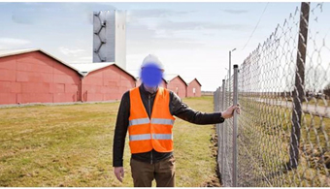
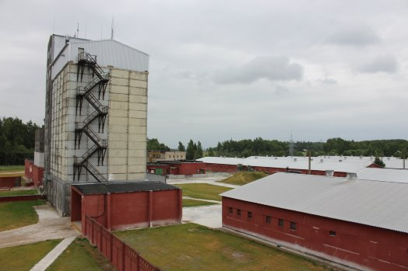
Interview with ASF outbroken farm in Lithuania
ASF experiences of a Dane who managed swinery in Lithuania
The farmer said “Everything seemed fine until the morning of that day when some sows did not eat food. When I looked around the farm, about five heads of sow were dead.
All the other sows had a high fever. I believed that there was something wrong going on. On the next day, together with the Chief Operating Officer, we concluded that something was definitely wrong with this farm. We notified this to a veterinarian of the local public service and asked a Dane veterinarian to visit our farm. The Dane veterinarian immediately came by plane, and it was about 11:00 pm when we directly picked up him at the airport. When we got back to the farm, approximately 40 heads of sow were dead. It was in a moment of time.”
ASF outbroken farm in Lithuania

Slide 13
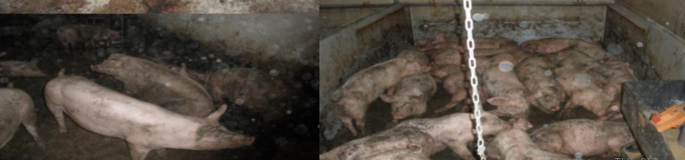
Interview with ASF outbroken farm in Lithuania
The farmer explained that “It was the worst situation I have ever seen” for what happened in the farm at that time. The virus has left a deep impression on him.
“I never saw that sort of a thing in the past. There is nothing you can do in such a situation except for making a notification about it. All sows that were once healthy were breathing heavily and dying out in pain. We were sure that it was ‘swine fever.’ The organs of sows must have been bleeding. If the bleeding were from the heart, they would have been dead immediately, and the bleeding from other organs would have killed the animals slowly.”
“As I recall the situation, the etiologic agents of deaths were spread all over the place. Nevertheless, no one could think that it was ‘African Swine Fever’ at that time. In the past, the veterinarians, who were civil servants of Lithuania, introduced how our farm was excellently managing biosecurity. Therefore we were sure that African swine fever could never enter our farm.”
* Data provided by: Lee Seungyun, the veterinarian from Han Byol Farm Tech

Slide 14
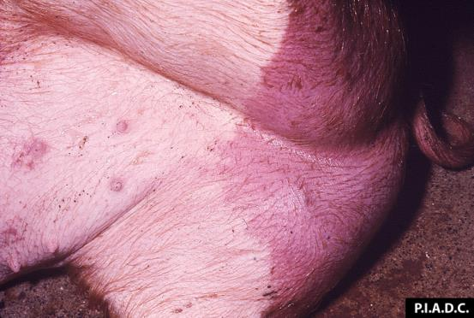
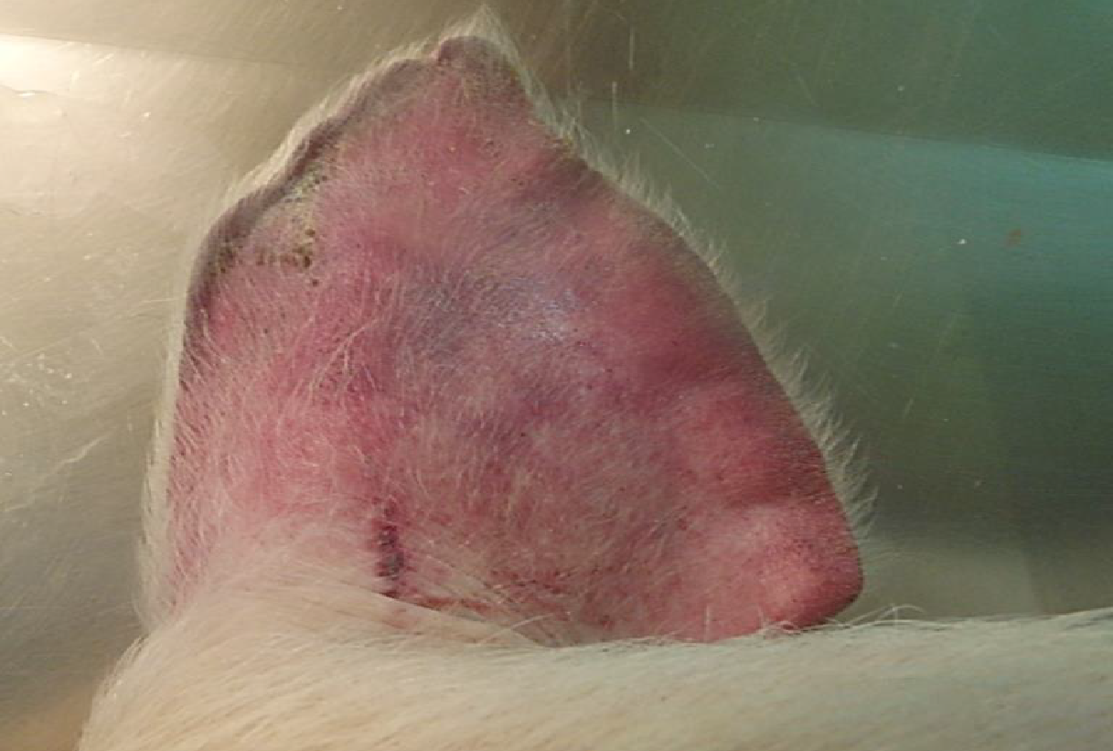
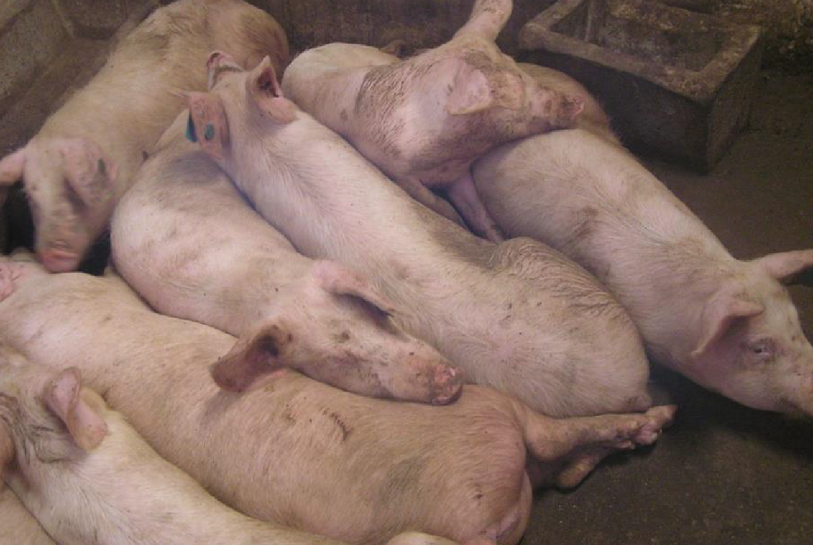
1) Prompt report if high fevers
and deaths increase
The most important roles of farms are having
early detection and making rapid reports.
Immediately report if an increase of high fever and deaths of
livestock with unknown causes are observed!
- Report calls for suspicious farms (Quarantine Agency) 1588-9060/4060 -
All farmers and workers must be fully aware of the major symptoms
of ASF and perform regular clinical inspections!

Slide 15
2) Understanding of the major symptoms
for early detection
There are a variety of clinical manifestations depending on the pathogenicity of infected viruses, and they are mostly identified
as acute and subacute.
<Acute>
Livestock may suddenly die within 1-4 days without showing
particular clinical manifestations.
Immediately report if the sudden increase in livestock deaths
with unknown causes.

Slide 16

2) Understanding of the major symptoms
for early detection
<Subacute>
(Main symptoms) High fever, reduced vitality, red spots,
cyanoderma, bloody excrement, miscarriage, death
(High fever) High fever above 41℃, increased breathing rate
* Piglets show high fever symptom in early stage (2~3 days after infection)
(Reduced vitality)
Motility decreases and
the pigs are piled up.

Slide 17
2) Understanding of the major symptoms
for early detection
(Red spots on the skin and cyanoderma) Ear, head, belly, rump, legs
(Bloody excrement) Mainly observed in the stage before death.
(Death) Death after 6~10 days of infection,
“Death rate increases after high fever.”

Slide 18
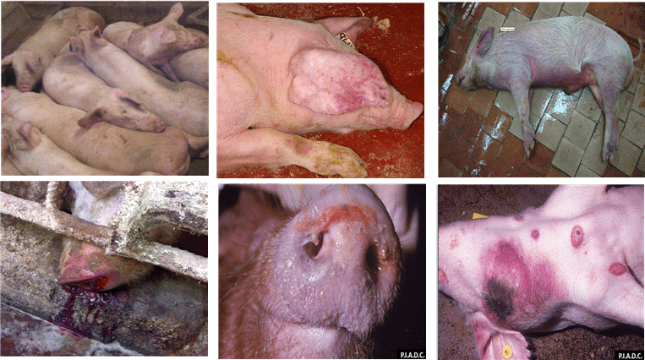
2) Major symptoms for early detection <Summary>
1
2
3
4
5
6
1. Pigs are piled up (Source: EURL INIA-CISA) 2. Petechial ears (Photo: Linda Mur.),
3. Rubefaction and congestion of acra and belly 4. Bleeding of nasal cavity (Source: Russia VNIIVVIM)
5. Mange with hemic mucous foam* 6. Congestion/bleeding of skin and sign of necrosis*
* Source: www.cfsph.iastate.edu, Center for Food Security and Public Health, Iowa State University, CVM.

Slide 19

3) Always heat leftover foods when
feeding the pigs
384 pig farms (9,300 heads) in Korea feed leftover foods, and 96 of them do not heat
the foods when feeding the pigs. (Based on Apr-May 2018, investigation result from
the Ministry of Agriculture, Food and Rural Affairs-Livestock Health Control Association)
Pig farms feeding leftover foods must heat the foods for more than 30 minutes at 80℃
(core temperature) in accordance with the standards of the Control of Livestock and
Fish Feed Act.
Countries in Europe including England warn the risk of feeding leftover foods to pigs
considering the spread of ASF.
Image. ASF campaign material of England
“Warning of the risk of feeding leftover foods to pigs”

Slide 20
4) Quarantine compliances when
visiting overseas
Visiting countries with ASF outbreak including China is prohibited.
If unavoidably visiting such countries, visiting of farms and
livestock markets is strictly prohibited.
Approved countries for traveling:
(Countries without ASF, AI, and foot-and-mouth disease outbreaks)
Singapore, Japan, Western Europe, Northern Europe, etc.
(Countries with ASF outbreak)
19 countries in Africa/Europe/Asia after Jan 1st, 2016 (OIE Standards)
Africa (8 countries) | Europe (10 countries) | Asia (1 country)
South Africa, Zambia, Burundi, Kenya, Mali, Côte d'Ivoir, Cape Verde, Nigeria | Russia, Ukraine, Moldova, Romania, Poland, Hungary, Czech Republic, Latvia, Estonia, Lithuania | China
Bringing livestock products to Korea such as meat, ham, and sausage sold
in the travel sites is strictly prohibited.

Slide 21
4) Quarantine compliances when
visiting overseas
Maintain a high level of personal hygiene
(taking a shower, etc.) right after returning to Korea.
Do not enter livestock farming facilities for five days.
Immediately wash the clothes and shoes you wore during the trip.
Report and disinfect yourself when entering the country with
infectious disease in domestic animals outbreaks (including layover).
- Violation may charge the fee of 5,000,000 KRW or less.

Slide 22
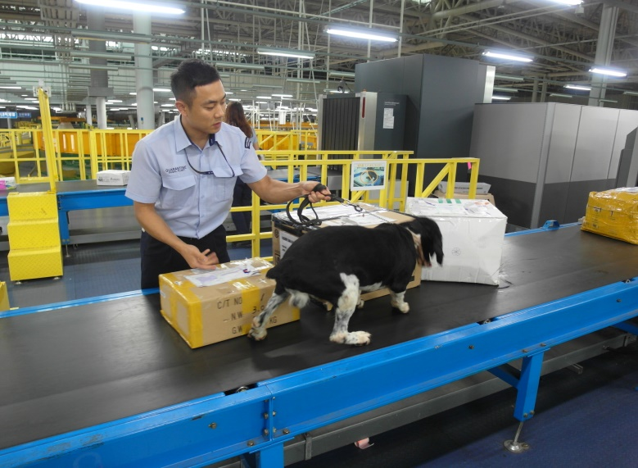
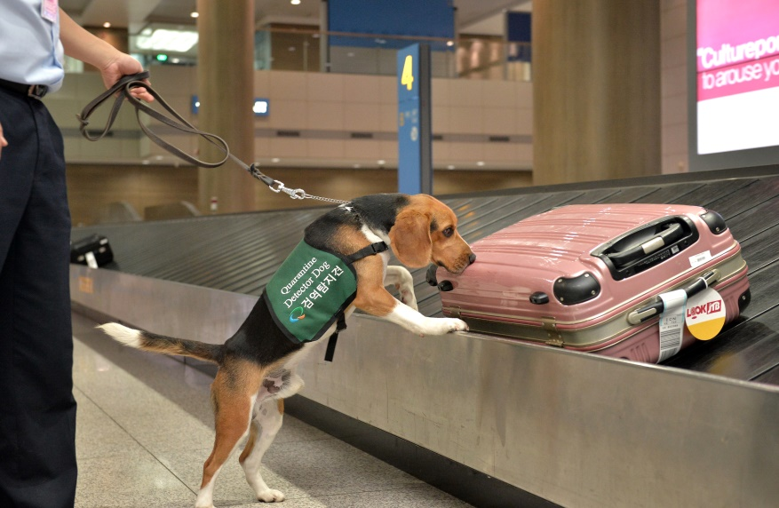
5) Quarantine management of foreign workers
The farm owner should inform the workers about prevention training for ASF.
Educate the foreign workers not to bring livestock products from
their countries by hand or post.
Once the farm owner or coworkers discover any livestock products
carried from outside Korea, immediately dispose of all items including
the wrapping.
<Fines will be imposed as illegal possession of livestock products is
discovered at the airport and harbor quarantine.>
- About 2,000 cases are charged with a fine for a year, and
the average fee is 1,000,000 KRW for each case.

Slide 23
5) Quarantine management of foreign workers
Process of the quarantine management of foreign workers who visited their homeland
- (Overseas sojourn) Prohibition on visiting livestock farms and markets
in their homeland.
- (Before departure) Self-inspection and dispose of livestock products
possessions by workers before boarding on the airplane.
- (Right after the entry) Report to the quarantine agency at the airport or harbor
and proceed with disinfection.
- (In Korea) Separate preparation of lodging instead of
the lodging in the farm (recommended).
Immediate washing of the clothes and shoes worn during
the trip right after coming back to Korea.
Thorough individual hygiene management such as taking a shower.
Prohibition on visiting the farm for five days.
When returning to the farm, the manager should recheck
the hygiene conditions and possession of livestock products.

Slide 24
5) Quarantine management of foreign workers
Compliance details of foreign workers about the quarantine within the farm
- Prohibition on ordering the homeland’s livestock products (meat, meat products, etc.)
by mail to Korea.
- Prohibition on bringing the meat bought outside the farm on weekends or holidays.
- Before returning to your farm after weekends or holidays, be sure to wash the hands
if you met the managers of other farms.
- Prohibition on inviting the workers from other farms to the farm you are working at.
- Prohibition on visiting other farms.

Slide 25
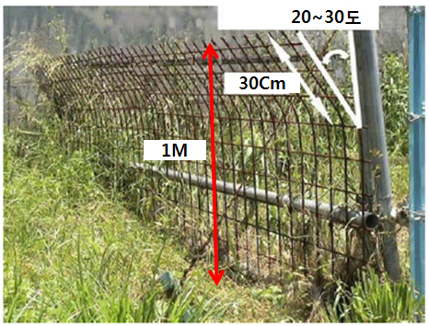
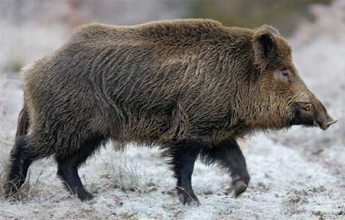
6) Blocking of the access of wild boars
Block the access of wild boars, and report and
do not make contact when they appear.
20~30 degrees
Remove any foods near the farm.
Prevent from exposure of food waste and
feed from the farm.
Remove any fallen berries or fruits near the farm.
Install a fence near the farm.
1m or more of height, space out the grid by 10cm.
Bent by 20~30 degrees towards the direction of wild boar approaching.
Report for the capture of injurious wild animals
in case of the wild boars are seen.
[Report to] Environment division and
the Complaints division of the local government
[Subject to report] Wild boars that harm human or
livestock or are appeared to cause harms.
Notes:
-

Slide 26
Thank you.

